Slide 1
Marginal Costing as a tool for decision making

Slide 2
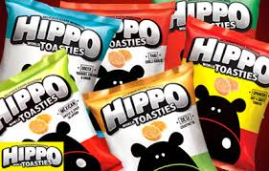
Poll based on Previous Lecture
Parle Agro has made the total sales of Rs. 500,000 by selling snack food items.
The P/V ratio was 40% and the profit earned was Rs. 10,000.
In such case, the fixed costs of the company will be:
200,000
180,000
500,000
190,000
Notes:
d

Slide 3
Learning Outcomes
Prepare marginal costing statements to resolve complex business problems relating to cost.
Develop decision making ability for business problems involving cost, profits and sales.

Slide 4


Introduction
Marginal costing technique provides assistance to management.
Assistance is with regard to short – term decision making where fixed costs are excluded.

Slide 5
Decision Making
Key factor
Make or Buy
Selection of Sales Mix
Desired Profit

Slide 6
A.) Key Factor or Limiting Factor
A factor which puts a limit on production and profit of a business.
The limiting factors are studied in the lights of the contribution.
Limiting Factor
Sales
Materials
Labour
Plant capacity

Slide 7
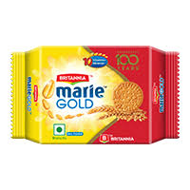
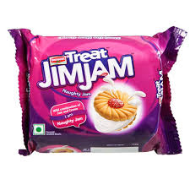

Key Factor at Britannia
Britannia is manufacturing three different varieties of biscuits namely, Marie Gold, Jim Jam and Good day.
All the three types of biscuit brands are manufactured from same set of machines.
Production is limited by machine capacity.
Indicate priorities for products Marie Gold, Jim Jam and Good day with a view to maximizing profits.

Slide 8
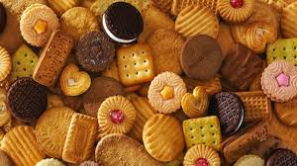
Key Factor at Britannia – Cost & Sales data
Particulars | Marie Gold | Jim Jam | Good day
Raw material cost per unit | 2.25 | 3.25 | 4.25
Direct labor cost per unit | 0.8 | 0.95 | 1.21
Selling price per unit | 5 | 6 | 7
Standard machine time required per unit | 39 minutes | 20 minutes | 28 minutes

Slide 9

Poll – II
Asian Paints is manufacturing three different products. The sales and cost data is presented below. The key factor is ‘raw material availability’.
In such case, the contribution in terms of key factor will be:
8.3 and 6
7 and 5
3 and 5
8.3 and 4
Particulars | Distemper | Matt
Selling price per unit | $40 | $50
Variable cost per unit | $15 | $20
Consumption of Material | 3 Kgs | 5 Kgs

Slide 10

B.) Make or Buy
Act of making a choice between producing an item:
internally (in-house)
or
buying it externally (from an outside supplier).
Apple Inc., making a choice related to iPhone manufacturing between
Producing part in California or
Assembling it from Chinese factory

Slide 11
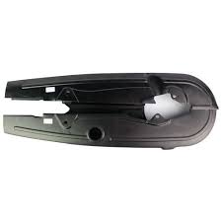
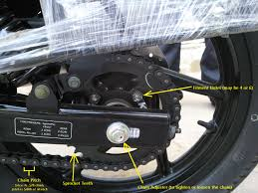
‘Make or Buy’ decision at TVS Motors
TVS Motors, a two wheeler manufacturing company, finds that the cost of manufacturing a chain guard in its own factory is Rs. 8.00 each.
The same is available in the market at Rs. 6.50 with an assurance of continuous supply.

Slide 12
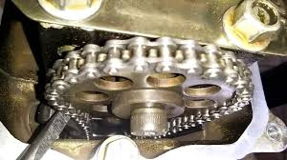
Make or Buy at TVS Motors
The cost data for manufacturing chain guard is as follows:
Materials Rs. 3
Direct labor Rs. 2
Other variable expenses Rs. 1
Fixed expenses Rs. 2
Suggest whether the company should make or buy this component?
How the answer will be different in case the supplier reduces the price from Rs. 6.50 to Rs. 5.50?

Slide 13

Poll – III
Intel discovers that while it costs Rs 6.25 per unit to make a component T in workshop, the same is available in the market at Rs 5.75 each.
The breakdown of costs is:
Materials is Rs 2.75 per unit,
Labor is Rs 1.75 per unit,
Other variable expenses is Rs 0.50 and
Depreciation and other fixed costs is Rs 1.25.
Shall the product be made in the factory or bought from the outside supplier?
Make the product in factory
Buy the product from outside supplier
Notes:
Make

Slide 14
C.) Selection of Suitable Product Mix
When a business manufactures more than one product, a problem is faced by it as to which product mix will give the maximum profits.
The best product mix is that which yields the maximum contribution.

Slide 15
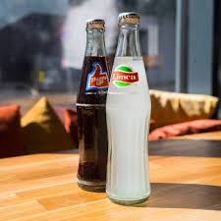
C.) Selection of Suitable Product Mix at Parlé Agro
Parle Agro, a food and beverage company is manufacturing two soft drinks.
It has presented the cost information related to the production of Thumbs Up and Limca.
The factory manager is interested in finding out the suitable product mix which will yield maximum profits.

Slide 16
Costing Information of Parlé Agro
Particulars | Thumbs Up | Limca
Direct material/unit | 10 | 9
Direct Wages/unit | 3 | 2
Variable expenses/unit | 3 | 2
Fixed Overheads Rs. 800
Following are the sales mixtures taken into consideration for the production of two soft drinks:
100 units of Thumbs Up and 200 of Limca
150 units of Thumbs Up and 150 of Limca
200 units of Thumbs Up and 100 of Limca

Slide 17
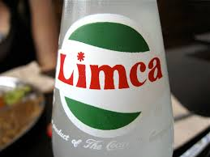

Selection of Suitable Product Mix at Parlé Agro
The total contribution and profits resulting from each of the following sales mixture when:
Selling price of Thumbs Up is Rs 20 and
Selling price of of Limca is Rs 15,
Recommend the factory manager which sales mixture should be adopted by the company

